Slide 1
Introduction to Databases

Slide 2
What’s Expected From You
Attend Lectures
If you don’t, you will miss out on things that you will need to know
Reading the slides is not enough
Be active and think critically
Ask questions. Come to office hours if you need to. Send email.
Do projects and homework
Start early and be honest
Study for tests
Respect the class and each other
Devices for notes only

Slide 3
A Few Quotes
“In God we trust. All others must bring data.”- W. Edwards Deming
“git actually has a simple design, with stable and reasonably well-documented data structures. In fact, I'm a huge proponent of designing your code around the data, rather than the other way around, and I think it's one of the reasons git has been fairly successful […] I will, in fact, claim that the difference between a bad programmer and a good one is whether he considers his code or his data structures more important.” – Linus Torvalds
Show me your flowcharts [code], and conceal your tables, and I shall continue to be mystified; show me your tables and I won't usually need your flowcharts [code]: they'll be obvious. – Fred Brooks

Slide 4
Big Data
The trendy folks talk about “big data” – what does that mean?
Big – more data then most people can reason about
Data – information
Where does this come from? Why does it matter?

Slide 5
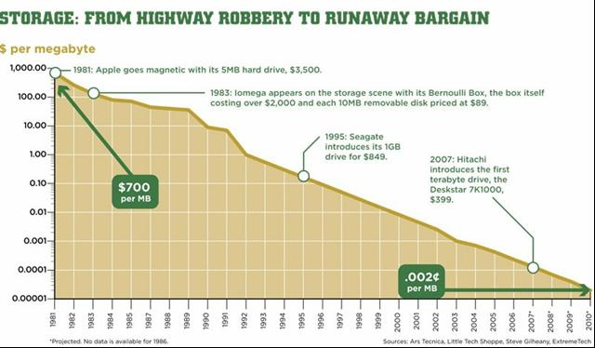
Unprecedented!

Slide 6
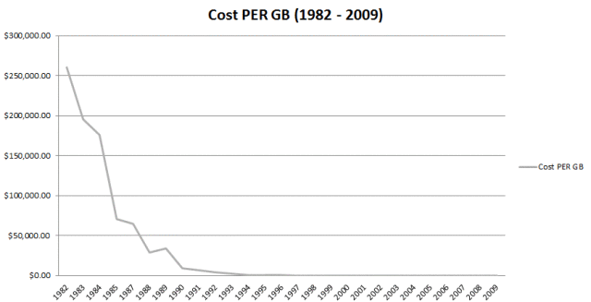

Slide 7
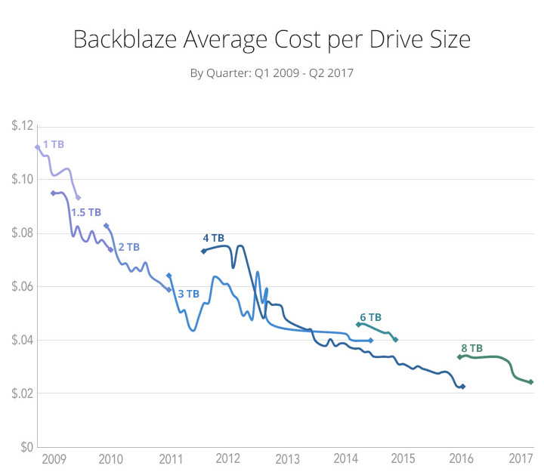

Slide 8
Why do I care?
You will never write a significant program that doesn’t store data.
In the “old days”, we had to be very particular about the data we saved.
Now, it is cheaper to stash data away somewhere “just in case” then it is to hold the meeting to decide to get rid of old data.
Organizations are realizing that there might be value in their data

Slide 9
In the news…
Artificial Intelligence
In order to train an AI model, you have to have a large training model.
Data Mining
To find interesting items in data, you need to be able to access it quickly and efficiently.
Business Intelligence
Business Intelligence is transforming raw data into meaningful and useful information used to enable more effective strategic, tactical, and operational insights and decision-making.

Slide 10
Lots of Work
Business Intelligence Specialist
Data Scientist
Database Administrator
Business Analyst
Systems Architect
ETL Developer (Extract, Transform, Load)
Data Modeler
Software Engineer
Quality Assurance

Slide 11


Excited yet?
The average organization doesn’t know how to effectively make use of their data.
They don’t even know the questions to ask!
Many organizations don’t even know what data they have or how it can help them.

Slide 12
Thought Experiment
Questions:
How would you store the records?
How would you deal with searching?
How would you represent the data?
How do you deal with multiple people living in the same house?
How do you deal with people having no email? People whose email you don’t know?
What if the city changes name?
What if the area code is renumbered?
How could we do a wild card search?
Assume that you have NO database available.
Your “job” is to implement a phone book for your community (dorm building, neighborhood, etc.)
“Users” can search by name, address, phone number.
“Admins” can add or edit entries as well as do everything a user can do.
You need to store name, address, city, region, postal code, phone number, email.

Slide 13
Some Potential Questions/Issues
When storing the data – fixed width or variable width fields? What if an edit is bigger than the old record?
What happens when a family moves away?
How fast is searching?
How long will it take you to write this? To test this? What if you need new features – how long will they take?
Can you support multiple users?

Slide 14
Common Problem
These are not unique issues to this (tiny) application.
Pretty much every application faces these issues (and more)
If everyone solved these problems with reading/writing text records out to a file, software wouldn’t ever get done…
“If three or more applications need functionality, it should be part of the runtime environment”

Slide 15
A very old problem
This problem is not new. Concurrency makes it worse.
In the 50’s, Cobol had a “record” type (think struct in Java). There was support in the language for writing these out to a file format called “ISAM” (indexed sequential access method).
Records had fixed width fields. ISAM writes the records out field after field. Because it is possible to compute the size of a field and a record, it is very quick and easy to jump to particular records (find the 10th).

Slide 16
What happened?
Cobol had this in the 50’s. Why doesn’t every programming language?
(My take) – every generation needs to reinvent all the things…
When PCs came out, they didn’t have the disk storage or the processing power. Also, the predominant programming languages (C, Pascal) didn’t come from a data/mainframe background.
That’s not to say that ISAM never made it to PCs or it can’t be done in C. It’s just not built in.

Slide 17
Definitions
Database Management System (DBMS) – program to manage databases
Database –set of structured data
Table – a set of data related to each other; subset of database
Schema – description of the types of items in the table (think class)
Row, Record or Tuple – a single entry in a table (think instance)
Field, Column or Element – a single category in a table (think members)

Slide 18
Problems with ISAM
Fixed length fields
File corruption
No way to tie tables together
Each program needs to know the definition of a table
Few/no tools for non-programmers
Sharing is hard

Slide 19
Database Management Systems
Instead of database management being part of the programming language, a DBMS is a program that manages all of the data in the data base.
With only one program (directly) reading and writing the file, corruption is dramatically reduced, sharing the data is easier, there is one source of metadata about the tables and tables can be tied together with enforcement.

Slide 20
Major DBMS in 2018
Oracle
DB2
Microsoft SQL Server
MySQL
PostgreSQL
There are others, too…

Slide 21
What will we cover in this course
My particular focus in this course is:
Database Design
A little on how DBMS work under the hood
SQL (Structured Query Language)
Interfacing a DBMS with a programming language
I don’t intend to be heavy on DBMS implementation, theory or any of the applications that can come with a DBMS. This is “Introduction”, not exhaustive. You can spend your whole life on DBMS and not learn everything.

